Slide 1
1-9: Summary – Week 1
By Barbara Oakley, PhD

Slide 2
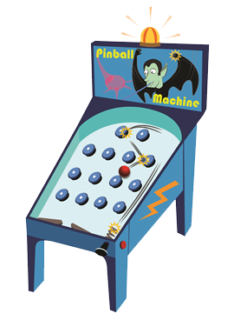

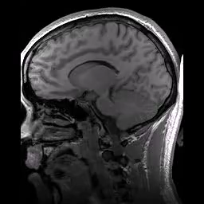

Slide 3
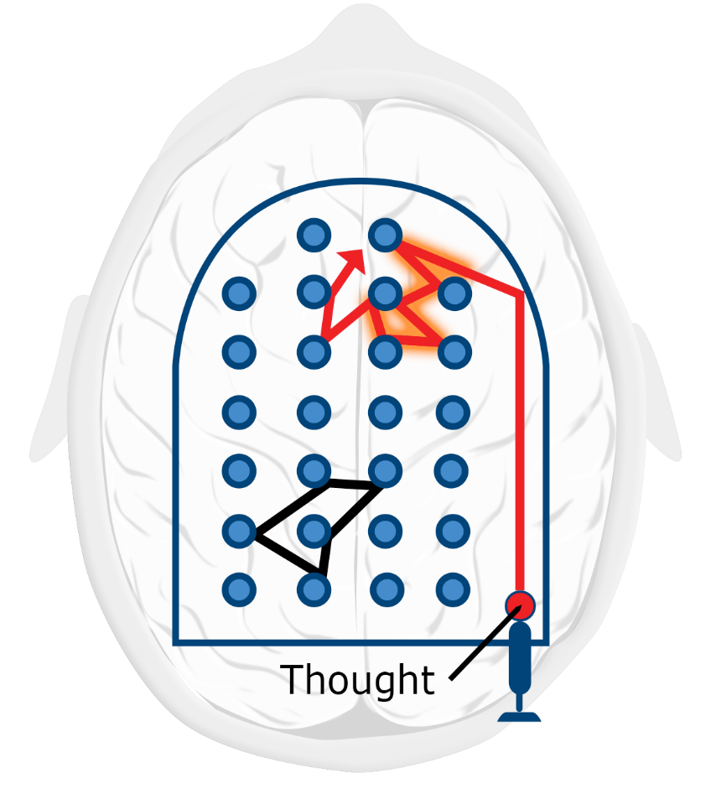
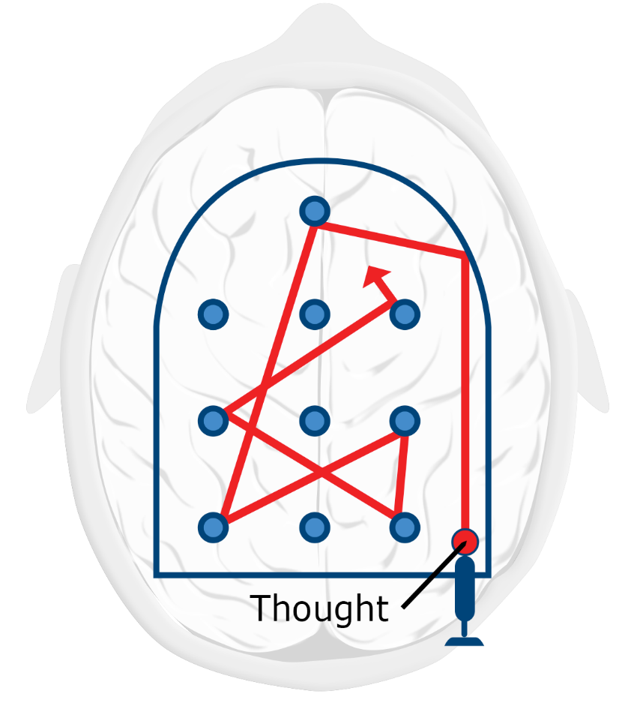
Focused
Diffuse

Slide 4
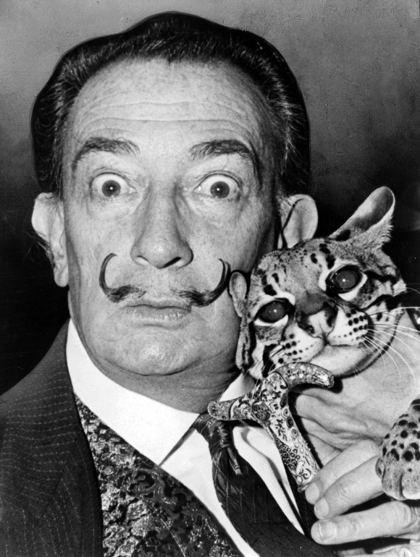
Thomas Edison
Salvador Dalí

Slide 5
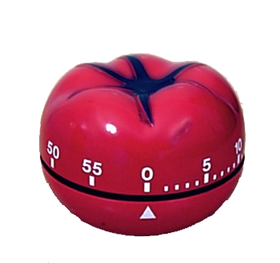

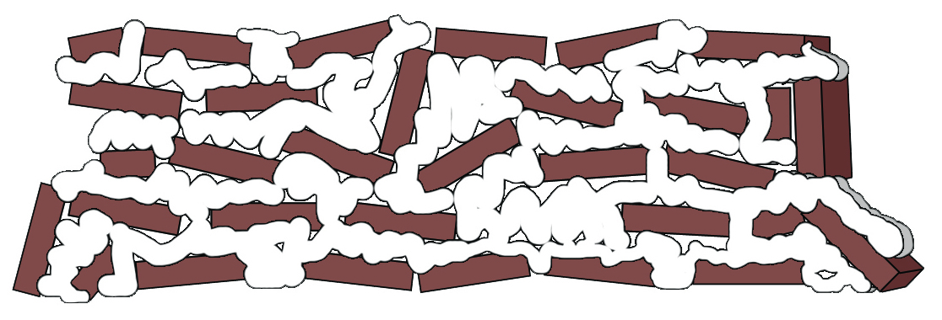
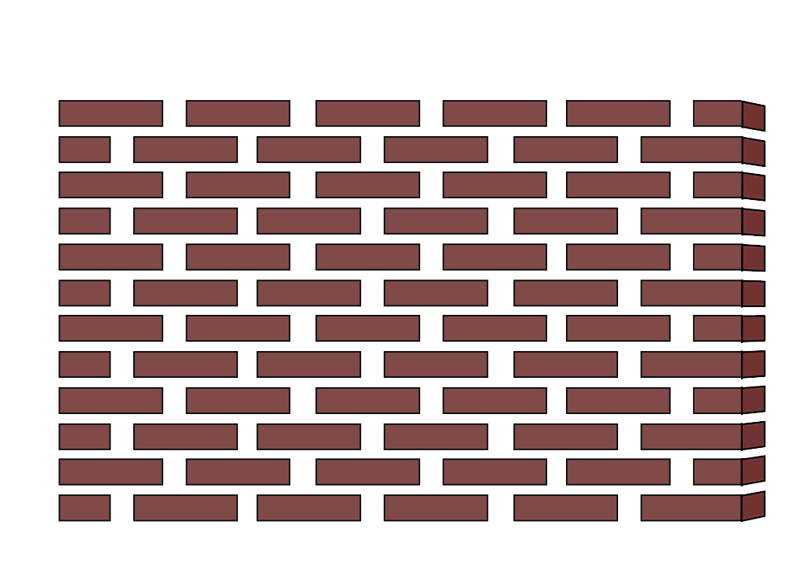

Slide 6
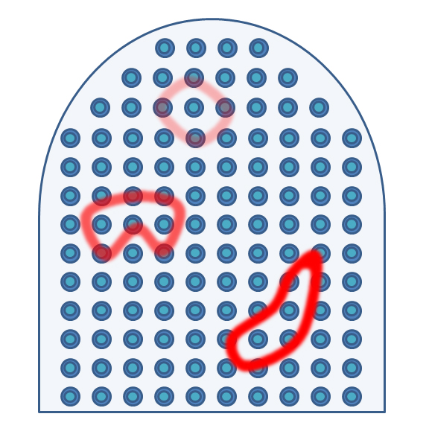


Slide 7



Working memory
Long term memory

Slide 8
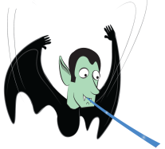
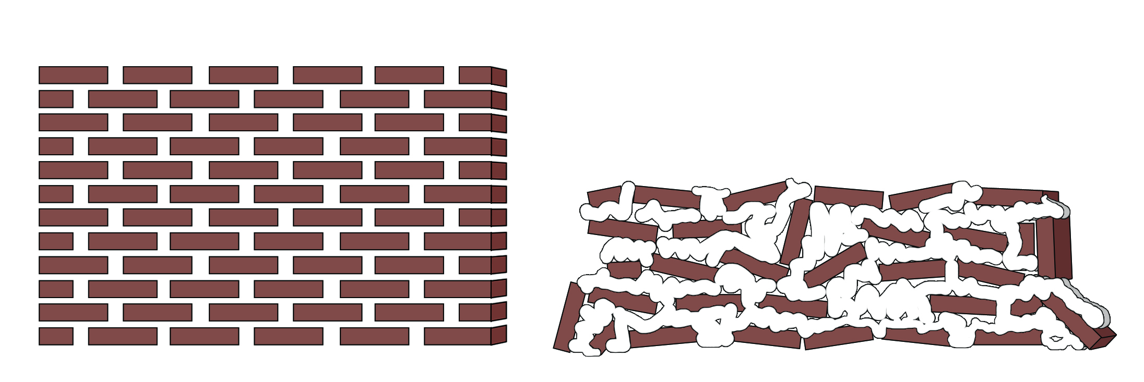
Monday | Tuesday | Wednesday | Thursday | Friday | Saturday | Sunday
Monday | Tuesday | Wednesday | Thursday | Friday | Saturday | Sunday

Slide 9
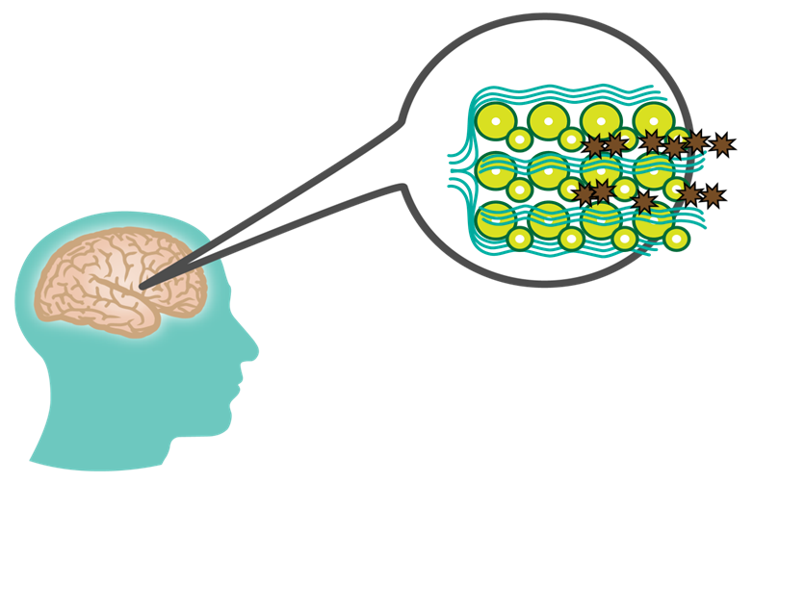

Slide 10
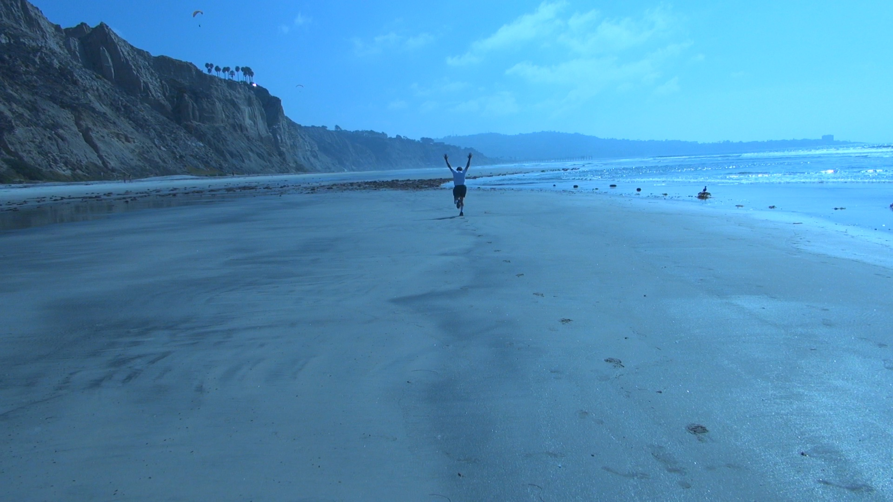

Slide 11
Image Credits
Animation of MRI images of a human head. Dwayne Reed, http://en.wikipedia.org/wiki/File:Structural_MRI_animation.ogv
Zombie ©Kevin Mendez, 2014.
Pinball machine©Kevin Mendez, 2014.
Neural pinball images and patterns©Kevin Mendez, 2014.
Thomas Edison, courtesy U.S. Department of the Interior, National Park Service, Thomas Edison National Historical Park
Salvador Dalí with ocelot and cane, 1965; http://en.wikipedia.org/wiki/ File:Salvador_Dali_NYWTS.jpg From the Library of Congress. New York World- Telegram & Sun collection. http://hdl.loc.gov/loc.pnp/cph.3c14985; Author: Roger Higgins, World Telegram staff photographer; no copyright restriction known. Staff photographer reproduction rights transferred to Library of Congress through Instrument of Gift.
Brick walls ©Kevin Mendez, 2014.
Brain during sleep animation ©Kevin Mendez, 2014.
Pomodoro timer, Autore: Francesco Cirillo rilasciata a Erato nelle sottostanti licenze seguirÃ OTRS, http://en.wikipedia.org/wiki/File:Il_pomodoro.jpg
Video of Dr. Terrence Sejnowski running, courtesy Philip Oakley.
Clip art courtesy Microsoft Corporation

